Slide 1
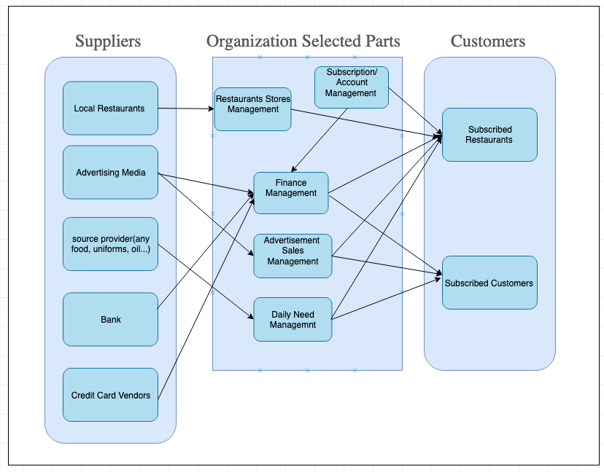
Super Servoli Systems Business Relationship Map

Slide 2
User Roles by Business Group
Business Group | User Roles | Team Member Name
Restaurants Stores Management | Partner Relationship Manager(responsible for local restaurant partners) | Poovadol
Advertisement Sales Management | Advertisement Sales Representative Food popularity trend Analyst Recipe Specialist | Jaepil
Subscription/ Account Management | Account Manager | Hao
Finance Management | Accountant | Ryan
Daily Need Management | Daily Need Manager Recipe Specialist | Andy P

